Slide 1
Time Series Analysis

Slide 2
Time Series
Time series forecasting is the use of a model to predict future values based on previously observed values.
A time series is a series of data points indexed or listed or graphed in time order.
Forecasting involves taking models fit on historical data and using them to predict future observations.
The purpose of time series analysis is generally two fold to understand or model the stochastic mechanisms that gives rise to an observed series and to predict or forecast the future values of a series based on the history of that series.
Time-Series Forecasting is the science and art of predicting events or data measurements in the future.
Time-Series Forecasting eliminates outright guessing by using mathematics, probability and statistics.
Assumptions in Time Series
Time series data should be equally spaced over time
Patterns of past data will propagate into future
Can not be used to predict random events(i.e. next tsunami etc.)

Slide 3
Time Series Plot
A time series plot is a two dimensional plot of variable values against time period. The vertical axis measures the variables of interest and the horizontal axis corresponds to the time periods.

Slide 4
Application of time series
Sales Forecasting
Budgetary Analysis
Stock Market Analysis
Inventory Studies
Economic Forecasting
Census Analysis

Slide 5
Components of Time Series
Trend – Secular trend or simple trend indicates the general tendency of the data to increase or decrease over a long period of time.
Seasonality – Seasonal variations are the variations in time series due to rhythmic forces which operate in a repetitive, predictable and periodic manner in a time span of one year or less.
Cyclical – Any pattern showing an up and down movement around a given trend is identified as a cyclical pattern. The duration of a cycle depends on the type of business or industry being analyzed.
Irregular – This component is unpredictable. Every time series has some unpredictable component that makes it a random variable. In prediction, the objective is to “model” all the components to the point that the only component that remains unexplained is the random component.

Slide 6
Trend
The term long period of time is a relative term and cannot be defined exactly. In some cases, 2 weeks may or may not be a long period of time. For example, to control an epidemic, 1 Week is considered as a long period of time.
A trend is the general direction of a market or the price of an asset, and trends can vary in length from short to intermediate, to long term.
Examples of secular upward trend are: Prices, Pollution, literacy rate, Production, etc.
Examples of secular downward trend are: Rate of infant mortality, death rate due to epidemics owing to advancements in medical facilities
Taking averages over a certain period is a simple way of detecting trend in seasonal data.
Change in averages with time is evidence of a trend in the given series, though there are more formal tests for detecting trend in time series.

Slide 7
Seasonality
The seasonal component consists of effects that are reasonably stable with respect to timing, direction and magnitude.
The seasonal fluctuations can be measured only if the date are recorded hourly, daily, weekly, monthly, quarterly.
The seasonal variations the time period should not exceed one year.
There are three reasons for the study of seasonal variations:
We can establish the pattern of the past changes,
The projection of past patterns into the future is a useful technique of prediction,
The effects of seasonality can be eliminated from the time series after their presence is established.
Types of seasonal variation
✓ Seasonal variations due to natural forces: There are variations in time series due to weather conditions and climatic changes.
For Example: Sales of umbrellas zoom up during rainy season, Sale of ice cream zoom up in summer.
✓ Seasonal variations due to customs: There are variations due to customs, habits, lifestyle, and conventions of the people in society.
For Example: Sale of sweets goes up during festival.

Slide 8
Cyclical Variation or Cyclic Fluctuations
Time series exhibits Cyclical Variations at a fixed period due to some other physical cause, such as daily variation in temperature.
Cyclical variation is a non-seasonal component which varies in recognizable cycle. Sometime series exhibits oscillation which do not have a fixed period but are predictable to some extent.
The period from the peak of one boom to the peak of the next boom is called a complete cycle.
Cyclical variations are not periodic but more or less regular in nature.
For example, economic data affected by business cycles with a period varying between about 5 and 7 years.
In weekly or monthly data, the cyclical component may describes any regular variation (fluctuations) in time series data.
The cyclical variation are periodic in nature and repeat themselves like business cycle, which has four phases
1. Peak, 2. Recession, 3. Trough/Depression, 4. Expansion.

Slide 9
Irregular Components
Irregular component is the residual variation remaining after the trend-cycle and seasonality have been extracted from original time series.
This component appears as short-term, unsystematic fluctuations around the trend that do not follow any systematic or repeated pattern, which could be captured by seasonal component.
Irregularity is formed from all unpredictable effects that affect time series, i.e.:
Unseasonable weather
Sampling errors
other errors.
Examples of Irregular components
Floods
Earthquakes
Wars
Famines

Slide 10
Components of Time Series

Slide 11
Smoothing
Smoothing is a statistical technique for removal of short term irregularities in a time-series data to improve the accuracy of forecasts.
Smoothing is a very common statistical process used in time series analysis.
When you use an average to describe something, the number we are using is a smoothed number.
For example, we observed a coldest winter. but, How do we find out this as a coldest winter?
We observed daily low and high temperatures for winter period of each year on recorded history. Now, we have a group of numbers that jump around quite a bit. We need a number to remove all this jumping.
The process of removing all these jumping around in the data is called smoothing. In this case we just use a simple average to accomplish the smoothing.

Slide 12
Smoothing
In demand forecasting, we use smoothing to remove random variation (noise) from our historical demand.
This allows us to better identify demand patterns (primarily trend and seasonality) and demand levels that can be used to estimate future demand
The most common way to remove noise from demand history is to use different statistical methods to normalize the effect of time series component:
✓ Simple Moving Average ✓ Weighted Moving average. ✓ Simple Exponential Smoothing ✓ Holts Exponential Smoothing/ Double Exponential Smoothing ✓ Winters Exponential Smoothing/Holts Winter Smoothing/ Triple Exponential Smoothing

Slide 13
Refer to excel named Day5_Excel_Sales.xlsx

Slide 14
Simple Exponential Method
Assume, in a weighted average where we consider all of the data points, while assigning exponentially smaller weights as we go back in time.
For example, if we started with a weight of 0.8, our weights will go back in time it approaching a big zero.
Weights in exponential Smoothing | (0.8)^1 | (0.8)^2 | (0.8)^3 | (0.8)^4 | (0.8)^5 | (0.8)^6 | (0.8)^7 | ..........
 | 0.8 | 0.64 | 0.512 | 0.4096 | 0.3277 | 0.26214 | 0.209715 | ..............

Slide 15
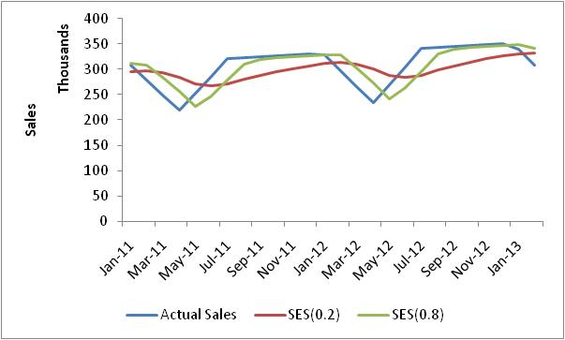
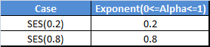
Single Exponential Smoothing
What is Single Exponential Smoothing ?
Exponential smoothing is simply an adjustment technique which takes the previous period's forecast, and adjusts it up or down based on what actually occurred in that period. It accomplishes this by calculating a weighted average of the two values. The formula takes the form:
F_{t+1} = α *D_{t} + ( 1 - α)* F_{t}
Ft- Forecasted Sales in t period , Dt- Actual Sales in t period, α – Data Smoothing Factor
α should lie in between 0 and 1 so that a part of difference between previous actual sale and forecasted sale is used in updating. If α is close to 1 then it has less smoothing effect and give greater weight to the recent changes in data. If α is close to 0 then it has greater smoothing effect and less responsive to recent changes in data.
How to decide better data smoothing factor in the above Simple Exponential Smoothing formula?
Qualitative Method to determine better α :
From Graph, qualitatively we can say Simple Exponential Smoothing with α=0.8 (SES(0.8)) is better than Simple Exponential Smoothing with α=0.2 (SES(0.2)) because SES(0.8) is more reactive to the change in sales than SES(0.2). Hence SES(0.8) should be preferred over SES(0.2) as a forecasting technique for the underlying data.

Slide 16
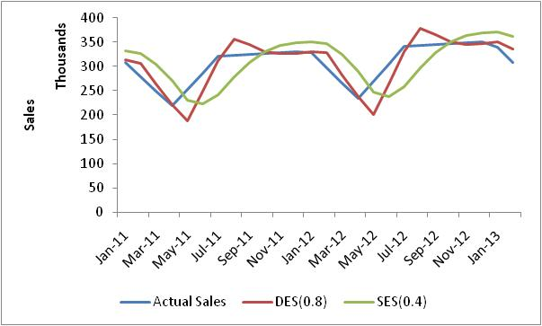
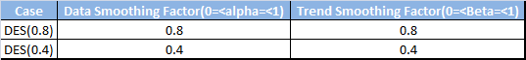
Double Exponential Smoothing
What is Double Exponential Smoothing ?
Simple exponential smoothing (SES) does not do well when there is a trend in the data. Double exponential smoothing performs better forecasting if data has trending factor in historical sales data. It basically uses two parameters – α (data smoothing factor) and β (trend smoothing factor). The formula for double exponential smoothing is given by:
when t=1 S1=X0,b1=X1-X0
when t > 1 St=α*Xt+(1- α)*(St-1+bt-1),
bt=β*(St-St-1)+(1-β)*bt-1
Xt+1=St+bt
α - Data Smoothing Factor
β - Trend Smoothing Factor
St - Smoothing component of forecasted value
bt - Trending component of forecasted value
Xt+1 – Forecasted value
α should lie in between 0 and 1, β should lie in between 0 and 1

Slide 17
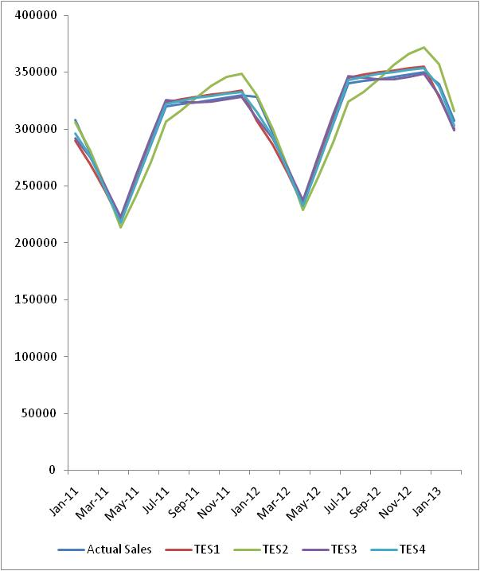
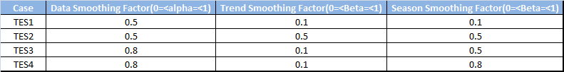
Triple Exponential Smoothing
What is Triple Exponential Smoothing ?
Double exponential smoothing (DES) does not do well when there is a trend and seasonality both in the data. In such situations, several methods were devised under the name “triple exponential smoothing“ .
Triple exponential smoothing is given by the formulas:
St=α(Xt/Ct-L+(1-α)(St-1+bt-1),
bt=β(St-St-1)+(1-β)*bt-1
Ct=ϒ(Xt/St)+(1-ϒ)*Ct-L
Ft+1=(St+bt)*Ct-L
St- Data Smoothing Component of Forecasted Value
bt- Trend Smoothing Component of Forecasted Value
Ct- Season Smoothing Component of Forecasted Value
α- Data Smoothing Factor (0< α <1), β- Trend Smoothing Factor (0< β <1), ϒ- Season Smoothing Factor (0< ϒ <1)

Slide 18
Lets get to R Code

Slide 19
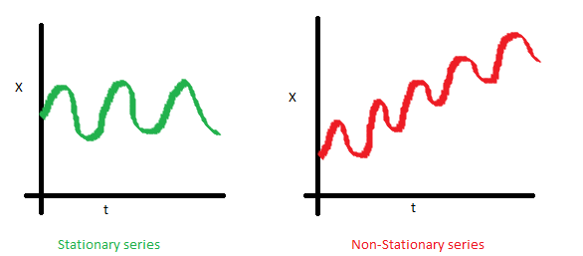
Stationary vs Non Stationary
Until unless your time series is stationary, you cannot build a time series model. In cases where the stationary criterion are violated, the first requisite becomes to stationarize the time series and then try stochastic models to predict this time series. There are multiple ways of bringing this stationarity. Some of them are Detrending, Differencing etc.

Slide 20
ARMA
ARMA models are commonly used in time series modeling. In ARMA model, AR stands for auto-regression and MA stands for moving average. Remember, AR or MA are not applicable on non-stationary series.

Slide 21
AR(1)
The current GDP of a country say x(t) is dependent on the last year’s GDP i.e. x(t – 1). The hypothesis being that the total cost of production of products & services in a country in a fiscal year (known as GDP) is dependent on the set up of manufacturing plants / services in the previous year and the newly set up industries / plants / services in the current year. But the primary component of the GDP is the former one.
Hence, we can formally write the equation of GDP as:
x(t) = alpha * x(t – 1) + error (t)
This equation is known as AR(1) formulation. The numeral one (1) denotes that the next instance is solely dependent on the previous instance. The alpha is a coefficient which we seek so as to minimize the error function. Notice that x(t- 1) is indeed linked to x(t-2) in the same fashion. Hence, any shock to x(t) will gradually fade off in future.

Slide 22
MA(1)
A manufacturer produces a certain type of bag, which was readily available in the market. Being a competitive market, the sale of the bag stood at zero for many days. So, one day he did some experiment with the design and produced a different type of bag. This type of bag was not available anywhere in the market. Thus, he was able to sell the entire stock of 1000 bags (lets call this as x(t) ). The demand got so high that the bag ran out of stock. As a result, some 100 odd customers couldn’t purchase this bag. Lets call this gap as the error at that time point. With time, the bag had lost its woo factor. But still few customers were left who went empty handed the previous day. Following is a simple formulation to depict the scenario :
x(t) = beta * error(t-1) + error (t)

Slide 23
Where to go, AR, MA or both
Two basic types of time series models exist,
Autoregressive
Moving average models.
So, what’s the big difference?
The AR model includes lagged terms of the time series itself
The MA model includes lagged terms on the noise or residuals
How do we decide which to use?
ACF and PACF

Slide 24
AR
An autoregressive model of order “p” AR(p)
X _{t} = β₁ X _{t −1} + β₂ X _{t −2} + ... + β _{p} X _{t − p} + e_{t}
Current value of X_{t} can be found from past values, plus a random shock e_{t}
Like a multiple regression model, but X_{t} is regressed on past values of X_{t}
The AR(1) Model
A simple way to model dependence over time is with the “autoregressive model of order 1”
“This is a OLS model of X_{t} regressed on lagged X_{t-1}"
X _{t} = β₀ + β₁ X _{t −1} + e_{t}
“What does the model say for the t+1 observation?"
^{X} t +1 ^{= β}0 ^{+ β}1 ^{X} t ^{+ e}t +1
“The AR(1) model expresses what we don’t know in terms of what we do know at time t"

Slide 25
MA
“A moving-average model of order “q” " MA(q)
X _{t} = e_{t} + β₁e_{t −1} + β₂e_{t −2} + ... + β_{q} e_{t −q}
“Current value of X_{t} can be found from past shocks/error (e), plus a new shock/error (e_{t})"
“ The time series is regarded as a moving average (unevenly weighted, because of different coefficients) of a random shock series e_{t}"
The MA(1) model
“A first order moving average model would look like":
X _{t} = e_{t} + β₁e_{t −1}
If β₁ is zero, X depends purely on the error or shock (e) at the current time, and there is no temporal dependence
If β₁ is large, previous errors influence the value of X_{t}
If our model successfully captures the dependence structure in the data then the residuals should look random

Slide 26
ARMA
Once we have got the stationary time series, we must answer two primary questions:
Q1. Is it an AR or MA process?
Q2. What order of AR or MA process do we need to use?
An ARMA(p, q) model is a combination of AR(p) and MA(q) models and is suitable for univariate time series modeling. In an AR(p) model the future value of a variable is assumed to be a linear combination of p past observations and a random error together with a constant term.
Just as an AR(p) model regress against past values of the series, an MA(q) model uses past errors as the explanatory variables.
Conceptually a moving average model is a linear regression of the current observation of the time series against the random shocks of one or more prior observations.

Slide 27
ACF plot: it is merely a bar chart of the coefficients of correlation between a time series and lags of itself.
The PACF plot is a plot of the partial correlation coefficients between the series and lags of itself.

Slide 28
How it works
First we determine the value of dd. We first check the stationarity of the data. If the data is stationary, then d=0d=0. If the data is trendy then we take the first difference and check for stationarity again. We keep taking differences until we get a stationary output. The number of difference required is the number dd.
There are different tools to detect stationarity. Visual observation of the data plot, auto correlation, variaogram are the most common.
After determining dd, we can utilize sample PACF (partial auto correlation) to get the AR order pp. If the PACF cuts off after some lags, that number is the order of AR.
We can determine the MA order q by looking at the sample ACF (auto correlation) of the differenced data. If the ACF cuts off after some lags, that number is the order of MA.

